Slide 1
Design Principles

Slide 2
Topic & Structure of the lesson
Six Design Principles

Slide 3
Design Principles
Visibility
Feedback
Constraints
Mapping
Consistency
Affordances
(Nielsen,1998)

Slide 4
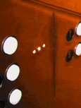
Visibility
This is a control panel for an elevator.
How does it work?
• Push a button for the floor you want?
• Nothing happens. Push any other button? Still nothing. What do you need to do??
It is not visible as to what to do!
www.baddesigns.com

Slide 5
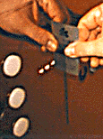
Visibility
      …you need to insert your room card in the slot by the buttons to get the elevator to work!
      How to make this action more visible?
      make the card reader more obvious ?
      provide an auditory message, that says what to do (which language?)
      provide a big label next to the card reader that flashes when someone enters?
      Other?

Slide 6
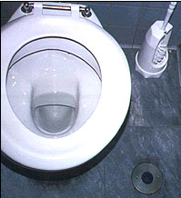
Visibility
      …the flusher is on the floor !!
      How to make this function more visible?

Slide 7
Visibility
  One of the most important design principles is visibility
Visibility is achieved by placing the controls in a highly visible location
Visibility is often violated in order to make things "look good"
Designing for visibility means that just by looking, users can see the possibilities for action

Slide 8



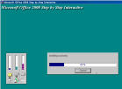

Feedback
Why add push-down effect
when the button is pressed?
Is this useful?
Why progress bar?
Why does the telephone touchpad provide audible feedback when the keys are pressed?

Slide 9
Feedback
Feedback is the provision of information to a user about the result of an action
When feedback is used in design, the system tells the user that it has done something in response to the user's input

Slide 10
Constraints
Constraints are properties of an object that limit the ways in which it can be used
When constraints are used in design, we reduce the possibility of users making errors
Jigsaws puzzle pieces utilise shape as well as the printed picture/pattern to provide constraints

Slide 11
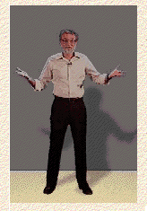
Constraints
Three main types to represent constraints (Norman, 1999)
  Physical
  Logical
  Cultural
a professor emeritus at University of California, San Diego, works mostly with cognitive science in the domain of usability engineering. Co-founded the Nielsen Norman Group, a consulting group on matters of usability which also includes Jakob Nielsen and Bruce Tognazzini.

Slide 12




Constraints (Physical)
The design of floppy disk drives allows the disk to be inserted in the correct way only
The design of video cassette drives allows the cassette to be inserted in the correct way only
Bank card can be inserted in certain way, keys on a pad can only be pressed in certain way. (ATM machine)

Slide 13
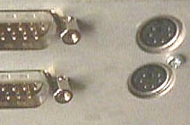
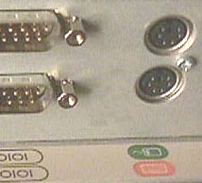
Constraints (Logical)
Where do you plug the mouse and keyboard?
top or bottom connector? trial and error? experience?
Do the colour coded
icons help?
www.baddesigns.com
Do you find them ambiguous?
How to design them more logically?

Slide 14


Constraints (Logical)
How to design them more logically?
(i) A provides direct adjacent mapping between icon and connector
(ii) B provides colour coding to associate the connectors with the labels

Slide 15
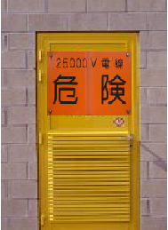





Constraints (Cultural)
How to represent Danger!??

Slide 16
Constraints (Cultural)
Cultural constraints rely on learned conventions
(e.g. red for warning, certain audio signals for danger, smiley face for happy emotions)
Once accepted by more than one cultural groups, they become universally accepted conventions.

Slide 17
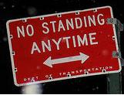

Constraints (Cultural)
Which are universal and which are culturally-specific?

Slide 18
Constraints
Restricting the possible actions that can be performed
Helps prevent user from selecting incorrect options

Slide 19
Mapping
Why is this a poor mapping of control buttons for the sequence of actions of fast rewind, rewind, play and fast forward?
Suggest a better mapping

Slide 20
Mapping
Why is this a better mapping?

Slide 21
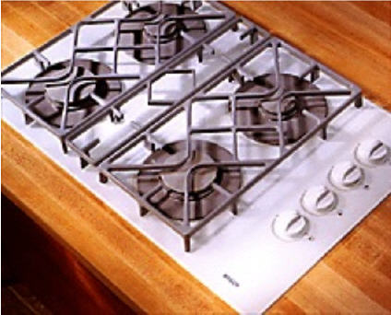





Mapping

Slide 22
Natural Mapping
Mapping is the relationship between controls and their action or effect in the world
Natural mapping takes advantage of physical analogies and cultural standards to provide the user with an understanding of how something works

Slide 23
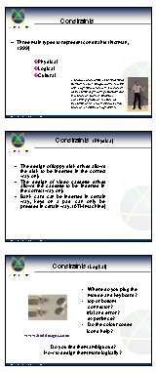
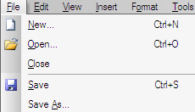
Consistency
Design interfaces to have similar operations and use similar elements for similar tasks
For example:
  Use of short cut keys
  always use ctrl key plus first initial of the command for an operation
  – ctrl+C, ctrl+S, ctrl+O
Main benefit is consistent interfaces are easier to learn and use

Slide 24
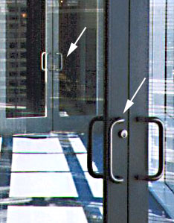
Affordances
This set of doors connects a walkway between two buildings
  Although both sides of both sets of
  doors have handles, only the outer
  handles are meant to be pulled
  Using either set of doors once inside
  the walkway, to exit, one needs to
  push
  Feel trapped??

Slide 25
Affordances
  properties of an object that indicate how it can be used

Slide 26
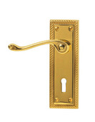









Affordances (Physical)
  Physical affordances:
    How do the following physical objects afford?
    Are they obvious?

Slide 27
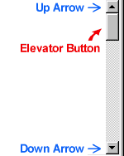


Affordances (Logical)
  Virtual affordances (logical)
    How do the following screen objects afford?
    What if you were a novice user?
    Would you know what to do with them?

Slide 28
Design Principles revisited
Visibility
  Placing the controls in a highly visible location
Feedback
  provision of information about the result of an action
Constraints
  Restricting the possible actions that can be performed helps prevent user from selecting incorrect options
Mapping
  Mapping is the relationship between controls and their action or effect in the world
Consistency
  Internal consistency refers to designing operations to behave the same within an application
  External consistency refers to designing operations, interfaces, etc., to be the same across applications and devices
Affordances
  properties of an object that indicate how it can be used

Slide 29
Q & A

